Slide 1

Xylo Hardware
Philipp Weidel
Neuromorphic R&D Engineer, SynSense AG

Slide 2
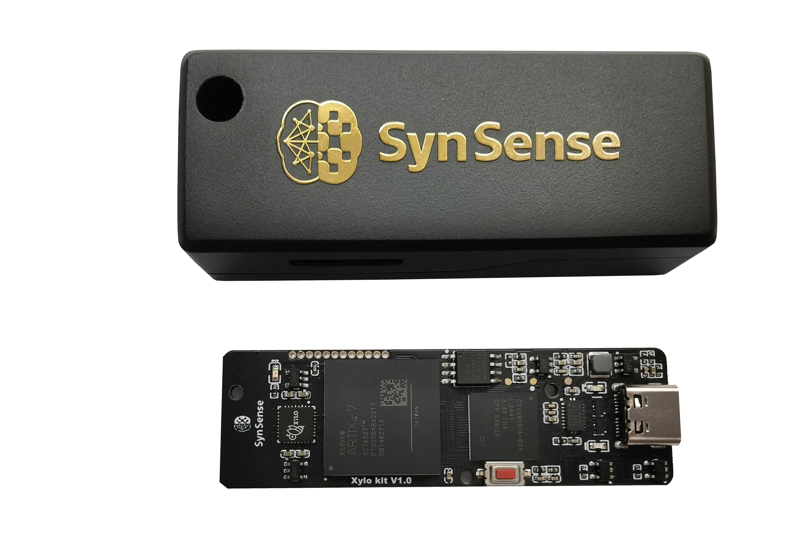
Xylo HDK
USB-C bus powered
Direct interface from Python for running network on device
Bit-accurate simulation in software
Deployment from trained network in two lines of Python code
Available now

Slide 3
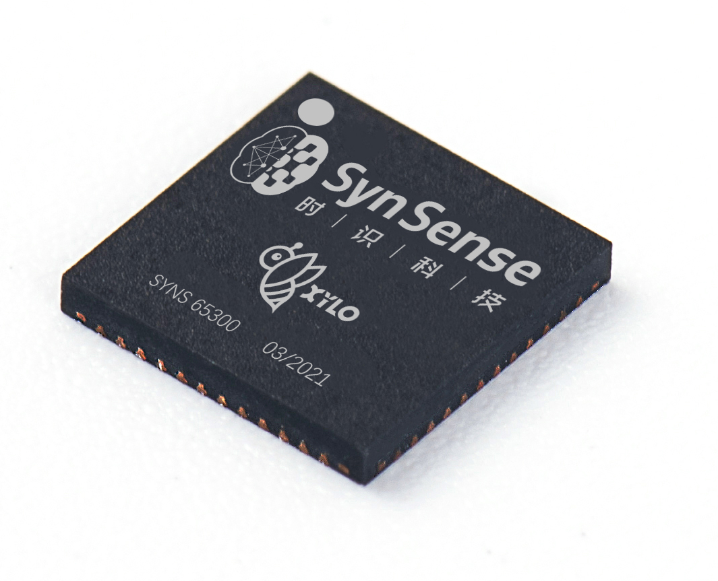
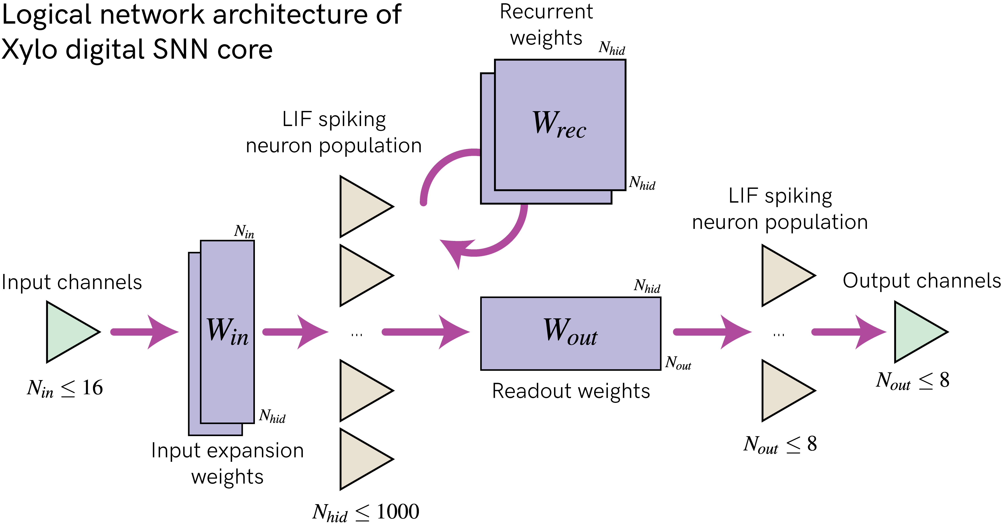
Xylo Overview

Slide 4
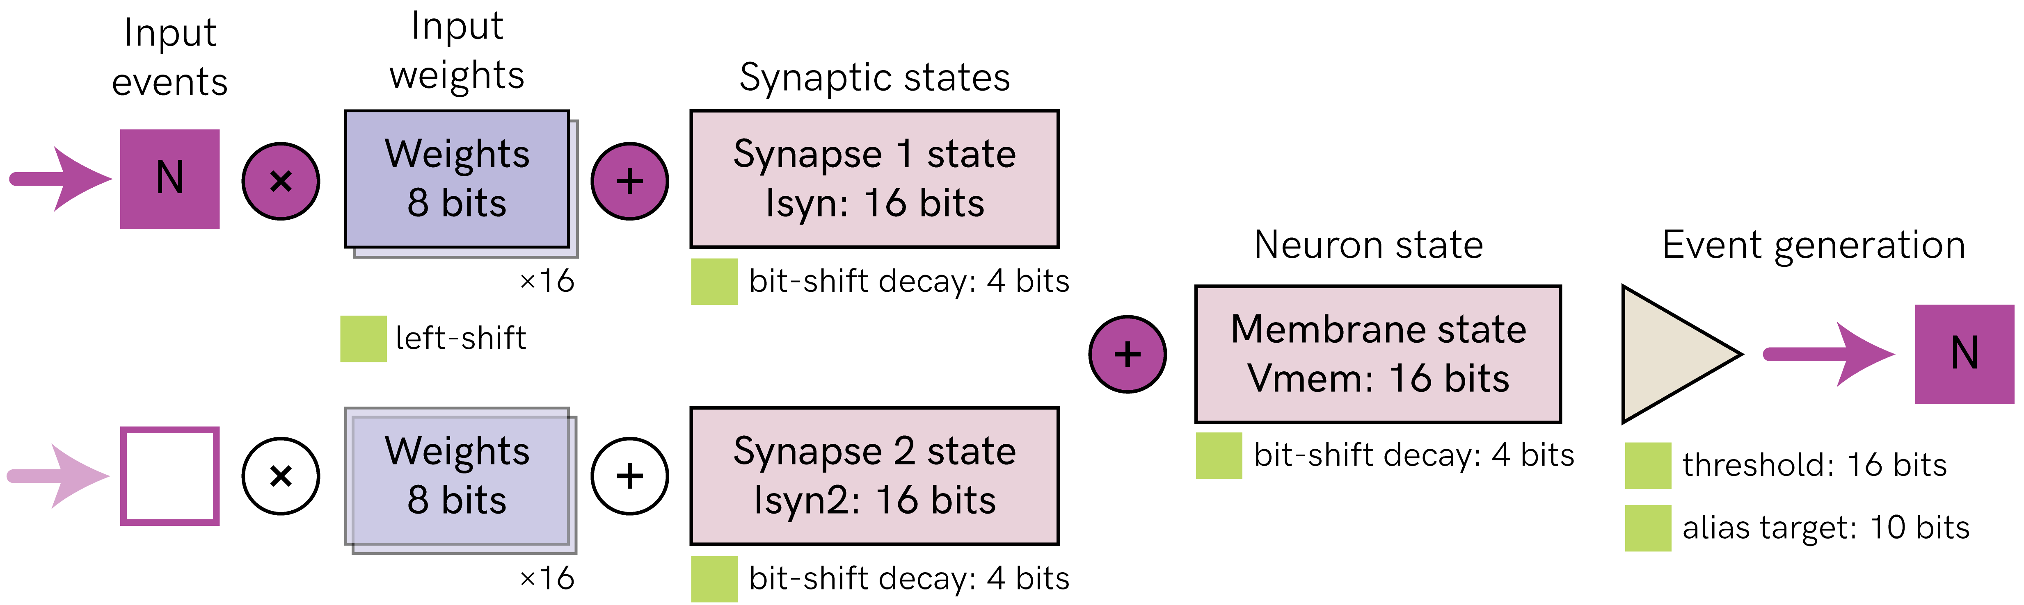
Xylo Neurons

Slide 5
Limitations and Constraints
Number of neurons
16 input channels
1000 hidden neurons
8 output neurons
Connectivity
Max fan out: 64
Avg fan out: 32
Integer arithmetic only
Addition, Subtraction, Bitshift
No multiplication / division
Bit-depth:
Weights: 8 bit signed integer
States: 16 bit signed integer
Approximated exponential decay through bitshifts

Slide 6


Thank you ！
Make Intelligence Smarter
Contact us
QiaoNing
Founder and CEO
000 0000 0000
Follow Us

